Slide 1
15 Taylor Series
汇报人：李**

Slide 2
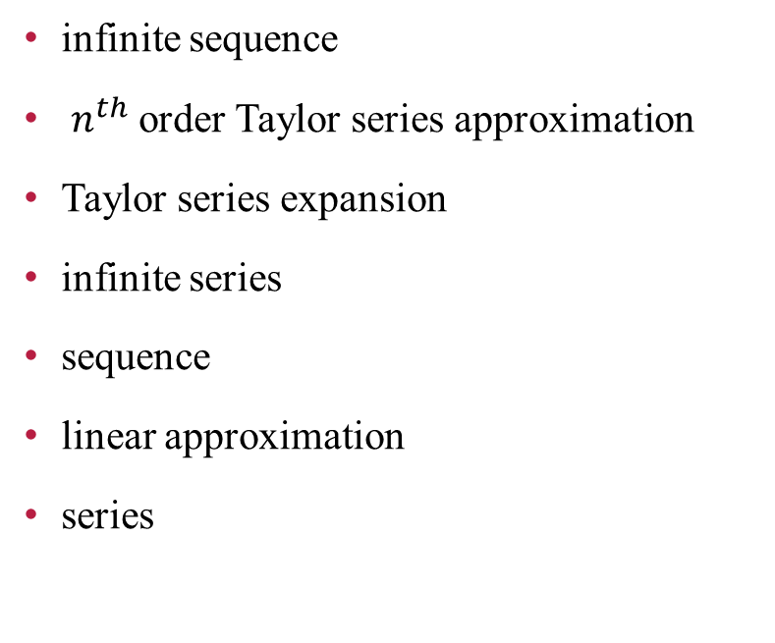
Vocabulary
infinite sequence
$n^{th}$order Taylor series approximation
Taylor series expansion
infinite series
sequence
linear approximation
series
无限序列
n阶泰勒级数逼近
泰勒级数展开
无穷级数
序列
线性逼近
系列

Slide 3
Chapter Outline
15.1 Expressing Functions with Taylor Series
15.2 Approximations with Taylor Series

Slide 4
Motivation
Many functions such as sin (x) and cos(x) are useful for engineers, but they are impossible to compute explicitly. In practice, these functions can be approximated by sums of functions that are easy to compute, such as polynomials. In fact, most functions common to engineers cannot be computed without approximations of this kind. Since these functions are used so often, it is important to know how these approximations work and their limitations.
In this chapter, you will learn about Taylor series, which is one method of approximating complicated functions. This chapter in no way takes the place of a full course on functional analysis, but it does provide exposure that will be useful for subsequent chapters.

Slide 5
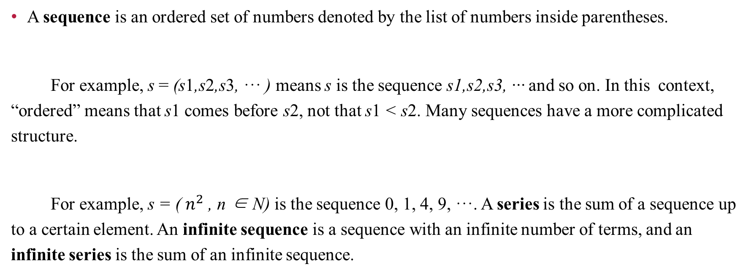
15.1 Expressing Functions with Taylor Series
A sequence is an ordered set of numbers denoted by the list of numbers inside parentheses.
For example, s = (s1,s2,s3, ··· ) means s is the sequence s1,s2,s3, ··· and so on. In this context, “ordered” means that s1 comes before s2, not that s1 < s2. Many sequences have a more complicated structure.
For example, s = ( $n^{2}$ , n ∈ N) is the sequence 0, 1, 4, 9, ···. A series is the sum of a sequence up to a certain element. An infinite sequence is a sequence with an infinite number of terms, and an infinite series is the sum of an infinite sequence.

Slide 6
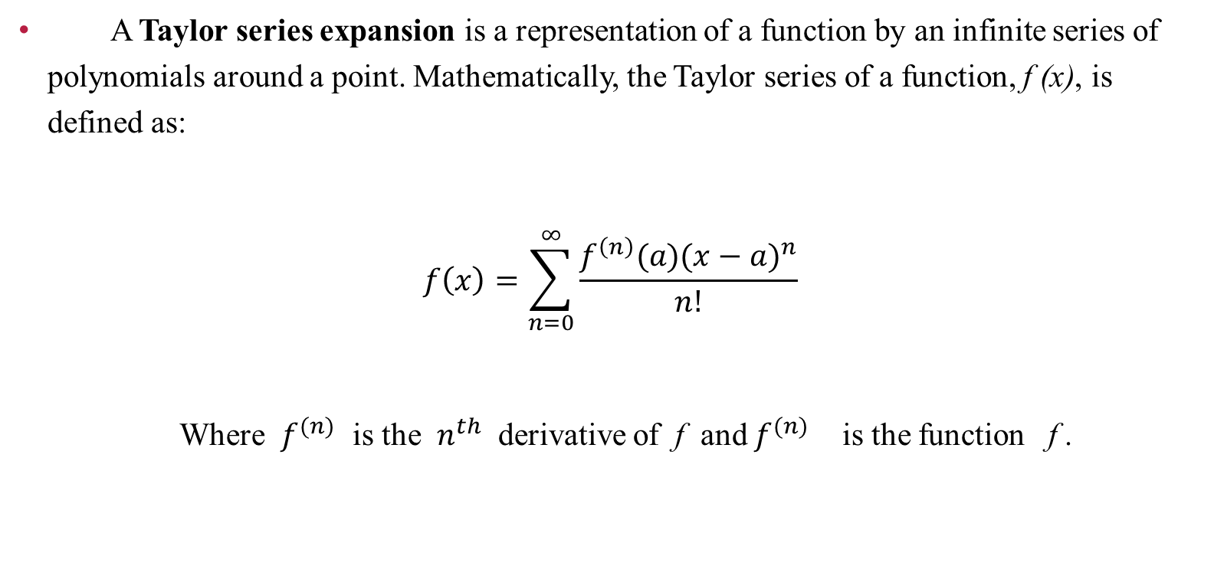
15.1 Expressing Functions with Taylor Series
A Taylor series expansion is a representation of a function by an infinite series of polynomials around a point. Mathematically, the Taylor series of a function, f (x), is defined as:
$$f\left(x\right)=\sum_{n=0}^{∞}{\frac{f^{\left(n\right)}(a){(x−a)}^{n}}{n!}}$$
Where $f^{(n)}$ is the $n^{th}$ derivative of f and $f^{(n)}$ is the function f .

Slide 7
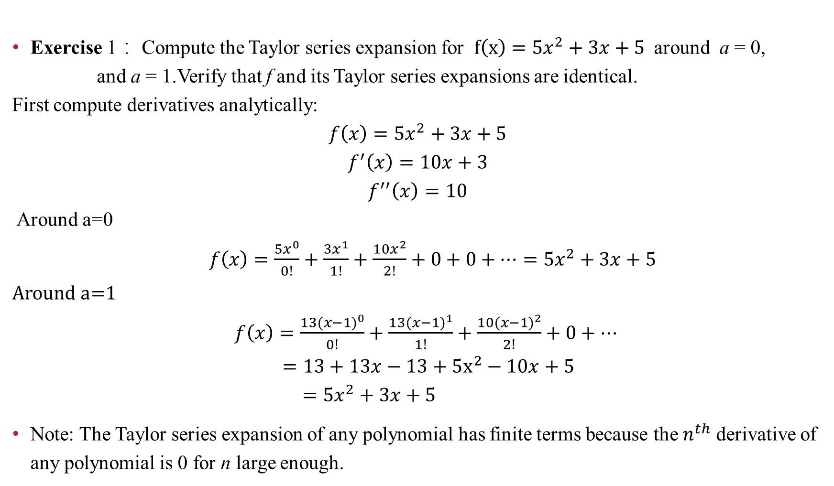
15.1 Expressing Functions with Taylor Series
Exercise 1： Compute the Taylor series expansion for $f\left(x\right)=5x^{2}+3x+5$around a = 0,
and a = 1.Verify that f and its Taylor series expansions are identical. First compute derivatives analytically:
$$f\left(x\right)=5x^{2}+3x+5$$
$$f^{′}\left(x\right)=10x+3$$
$$f^{′′}\left(x\right)=10$$
Around a=0
$f\left(x\right)=\frac{5x^{0}}{0!}+\frac{3x^{1}}{1!}+\frac{10x^{2}}{2!}+0+0+⋯=5x^{2}+3x+5$
Around a=1
$f\left(x\right)=\frac{13({x−1)}^{0}}{0!}+\frac{13{(x−1)}^{1}}{1!}+\frac{10{(x−1)}^{2}}{2!}+0+⋯$
$=13+13x−13+5x^{2}−10x+5$
$=5x^{2}+3x+5$
Note: The Taylor series expansion of any polynomial has finite terms because the $n^{th}$ derivative of any polynomial is 0 for n large enough.

Slide 8
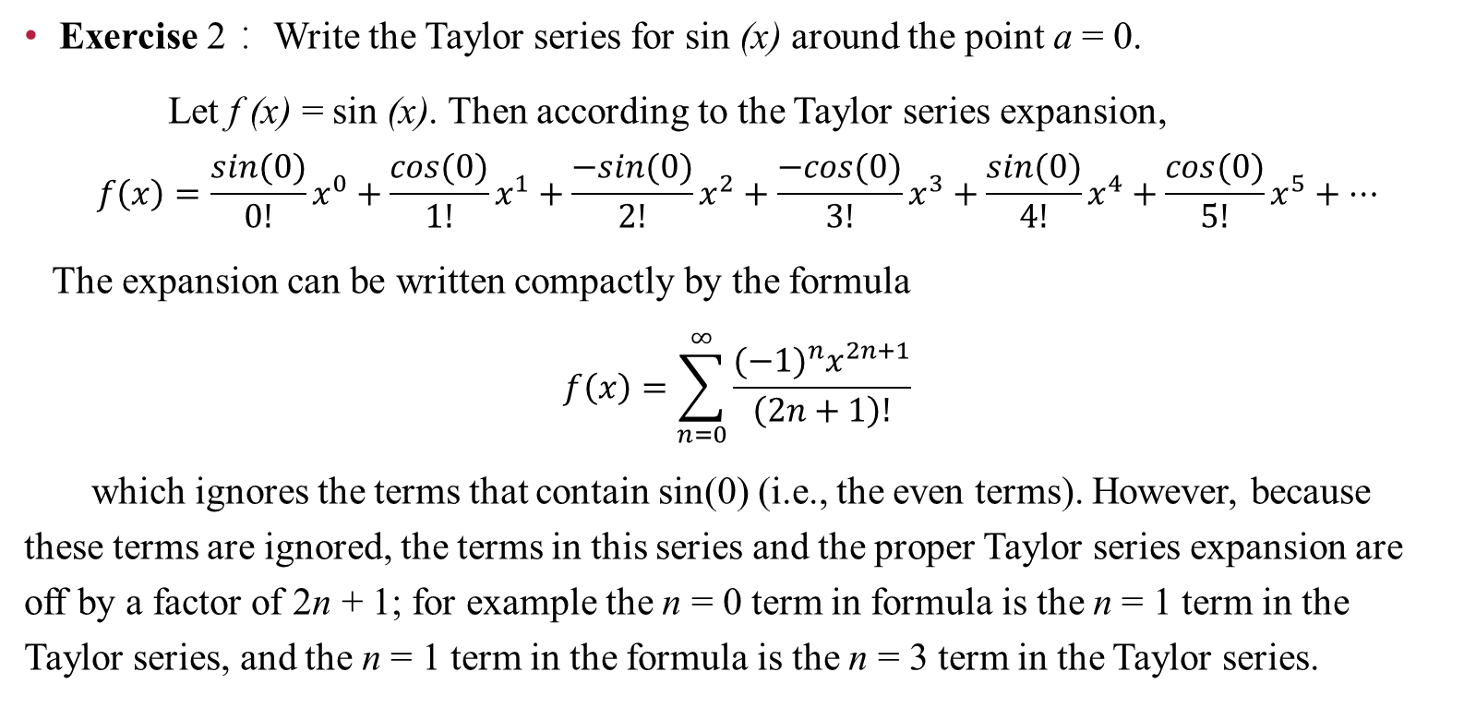
15.1 Expressing Functions with Taylor Series
Exercise 2： Write the Taylor series for sin (x) around the point a = 0.
Let f (x) = sin (x). Then according to the Taylor series expansion,
$$f\left(x\right)=\frac{sin⁡(0)}{0!}x^{0}+\frac{cos⁡(0)}{1!}x^{1}+\frac{−sin⁡(0)}{2!}x^{2}+\frac{−cos⁡(0)}{3!}x^{3}+\frac{sin⁡(0)}{4!}x^{4}+\frac{cos⁡(0)}{5!}x^{5}+⋯$$
The expansion can be written compactly by the formula
$$f\left(x\right)=\sum_{n=0}^{∞}{\frac{{(−1)}^{n}x^{2n+1}}{\left(2n+1\right)!}}$$
which ignores the terms that contain sin(0) (i.e., the even terms). However, because these terms are ignored, the terms in this series and the proper Taylor series expansion are off by a factor of 2n + 1; for example the n = 0 term in formula is the n = 1 term in the Taylor series, and the n = 1 term in the formula is the n = 3 term in the Taylor series.

Slide 9
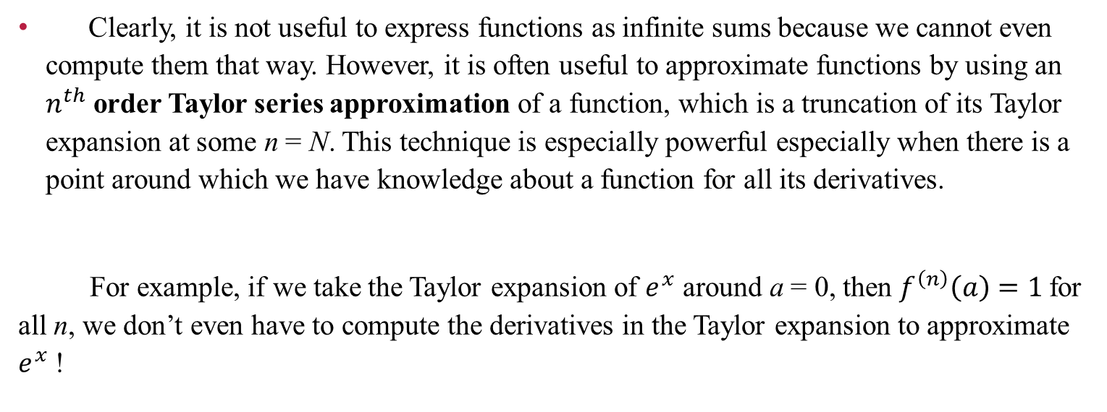
15.2 Approximations with Taylor Series
Clearly, it is not useful to express functions as infinite sums because we cannot even compute them that way. However, it is often useful to approximate functions by using an $n^{th}$ order Taylor series approximation of a function, which is a truncation of its Taylor expansion at some n = N. This technique is especially powerful especially when there is a point around which we have knowledge about a function for all its derivatives.
For example, if we take the Taylor expansion of $e^{x}$ around a = 0, then $f^{\left(n\right)}\left(a\right)=1$for all n, we don’t even have to compute the derivatives in the Taylor expansion to approximate $e^{x}$!

Slide 10
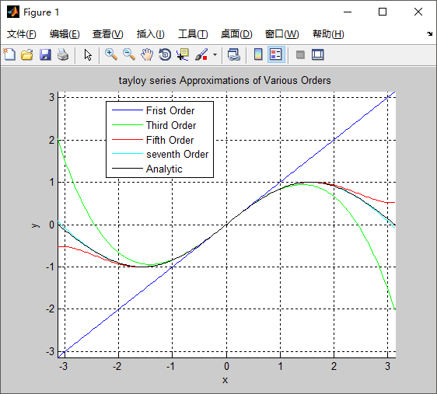
15.2 Approximations with Taylor Series
Exercise 3. Use MATLAB to plot the sin function along with the first, third, fifth, and seventh order Taylor series approximations. Note that this is the zero-th to third term in the formula given earlier. ( See Program 1 )
As you can see, the approximation approaches the analytic function quickly, even for x not near to a = 0.

Slide 11
15.2 Approximations with Taylor Series
Exercise 4： Compute the seventh order Taylor series approximation for sin (x) around a = 0 at x = π/2. Compare the value to the correct value, 1. ( See Program 2 )
The seventh order Taylor series approximation is very close to the theoretical value of the function even if it is computed far from the point around which the Taylor series was computed (i.e., x = π/2 and a = 0).

Slide 12
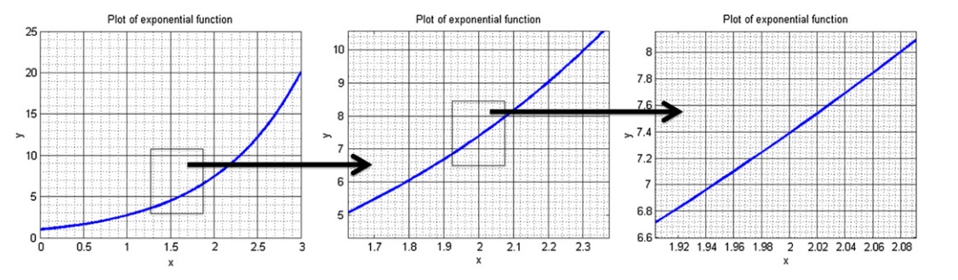
15.2 Approximations with Taylor Series
The most common Taylor series approximation is the first order approximation, or linear approximation. Intuitively, for “smooth” functions the linear approximation of the function around a point, a, can be made as good as you want provided you stay sufficiently close to a. In other words, “smooth” functions look more and more like a line the more you zoom into any point. This fact is depicted in Figure 15.2. Linear approximations are useful tools when analyzing complicated functions locally.
FIGURE 15.2 Successive levels of zoom of a smooth function to illustrate the linear nature of functions locally.

Slide 13
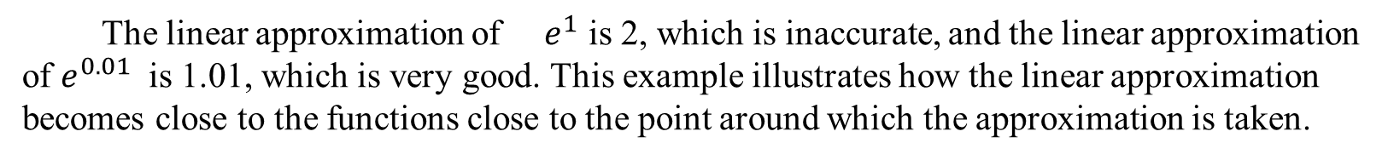
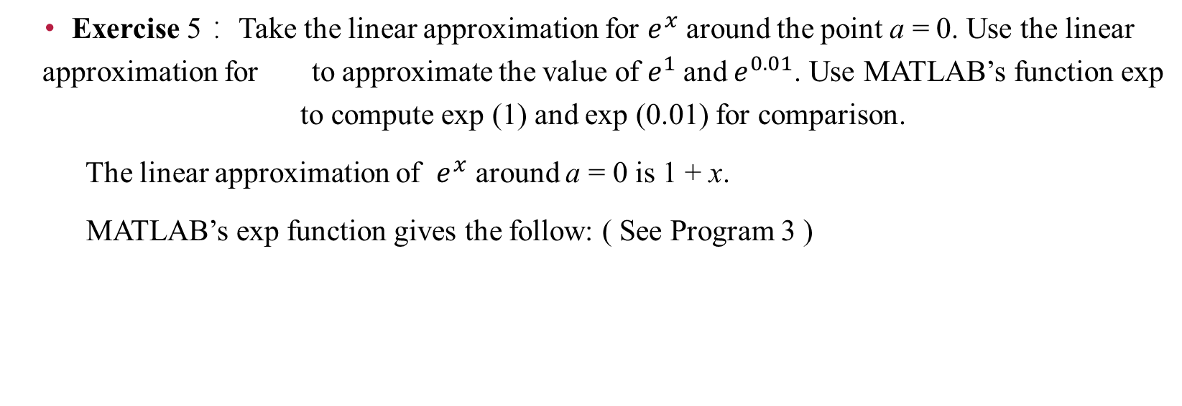
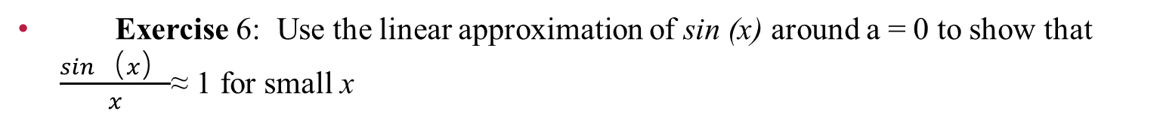
15.2 Approximations with Taylor Series
Exercise 5： Take the linear approximation for $e^{x}$ around the point a = 0. Use the linear approximation for to approximate the value of $e^{1}$and $e^{0.01}$. Use MATLAB’s function exp to compute exp (1) and exp (0.01) for comparison.
The linear approximation of $e^{x}$ around a = 0 is 1 + x.
MATLAB’s exp function gives the follow: ( See Program 3 )
The linear approximation of $e^{1}$ is 2, which is inaccurate, and the linear approximation of $e^{0.01}$ is 1.01, which is very good. This example illustrates how the linear approximation becomes close to the functions close to the point around which the approximation is taken.
Exercise 6: Use the linear approximation of sin (x) around a = 0 to show that $\frac{sin（x）}{x}$≈ 1 for small x

Slide 14
Summary
1. Some functions can be perfectly represented by a Taylor series, an infinite sum of polynomials.
2. Functions that have a Taylor series expansion can be approximated by truncating its Taylor series.
3. The linear approximation is a common local approximation for functions.

